Slide 1

EXPLORATORY DATA ANALYSIS ON
By : NITIN KUMAR
Notes:
Hi, I am nitin kumar & today I m representing exploratory data analysis on Airbnb, now we shall proceed.

Slide 2
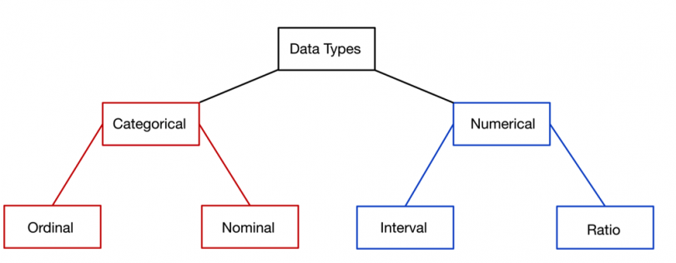
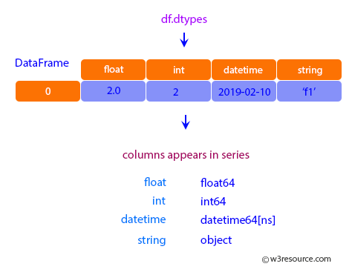
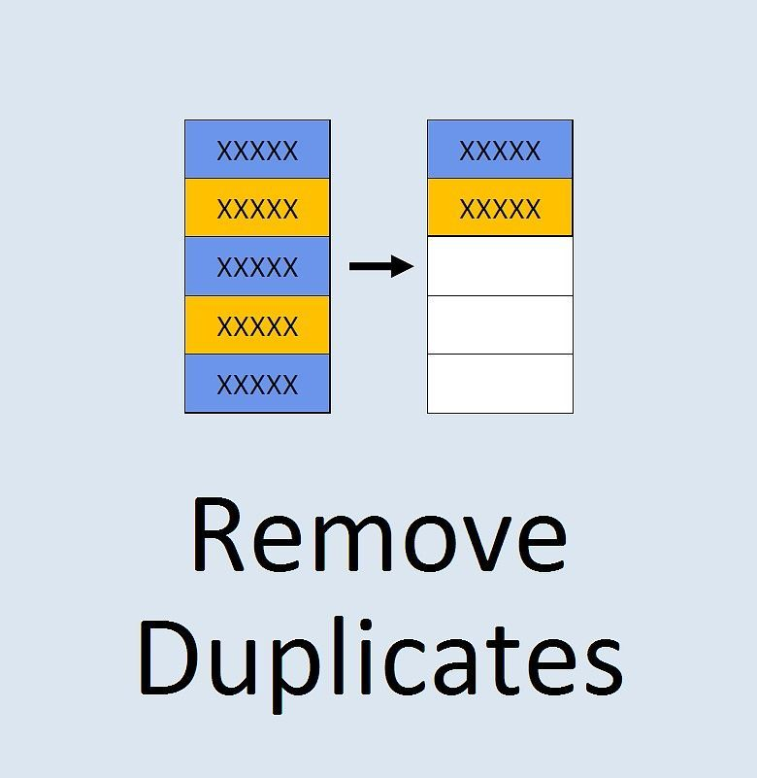
Contents in EDA
Data Extraction
Identify Categorical & Numerical Values
Check Data Types of Column
Duplicate Removal
Handle Null Values
Notes:
So these are the contents in eda. First we should know what eda is. Eda means analysing our data for taking out the conclusions and discover key understanding from the data. By help of this key understanding the company can overcome it’s drawbacks and gain higher profits. The first step of eda is exracting data and then we identify the categorical and numerical columns, in the next step we check data types of columns using info method where we get all info of numbers, strings, Boolean and null values. After this we remove the dupliates so we can get good insights. Then we handle the null values bcoz if we have null values in categorical column we have to remove them or if they are in numerical columns we will input the mean of that place in that place. Now lrts move to next slide

Slide 3


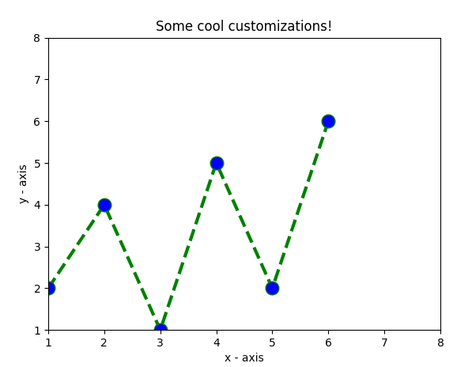
Contents in EDA
Outliers Handling
Fixing Invalid Data
Plotting Graphs
Observation & Conclusion
Notes:
Outliers are the extreme value which are irrelevant to the data we have. Next is invalid data. Invalid data is like true and false given in string which should be a Boolean. After that we plot the graphs so that we can discover key understanding from the data which is our main goal. So lets move to next slide

Slide 4
What is Airbnb & how does it works ?
Airbnb, Inc. is an American company that operates an online marketplace for lodging, primarily homestays for vacation rentals, and tourism activities.
The Company has come a long way since its co-founders first come up with the idea, back in 2007 back in recession, to invite paying guests to sleep on an air mattress in their living room. According to Airbnb’s latest data, it has in excess listing of 5.6 millions, covering more than 100,000 cities and towns in more than 220 countries.
Notes:
So heres the topic what air bnb is and how does it works. Airbnb incorporation is an American company that operates an online market place for loding, primarily homestays for vacations rentals and tourism activities. Like I am a person want to rent out my house or room, which will be a passive income for me so I can get paying guest from Airbnb . So lets move to next slide

Slide 5
Points for Discussion :
No. of apartments in different neighbourhood_groups
Price of apartments varying in different neighbourhood groups
Percentage of room types in every neighbourhood groups
Prices of room types in different neighbourhood group individually
Comparing the prices of room types for different neighborhood groups
Room type people prefer the most for staying
Neighborhood Group which got the most no. of visitors
Correlation between price, minimum nights & no. of review
Notes:
These are the main points for discussion.

Slide 6
Points for Discussion :
Availability of rooms in different 'neighbourhood_groups' Yearly
Availability of different types of room Yearly
In which year Airbnb recieves the most no. of reviews
Which year brought the most no. of visitors
Price fluctuation of each room type around the year
Which room types people prefer around the different months
Most no of active host in different neighbourhood group
Conclusion

Slide 7
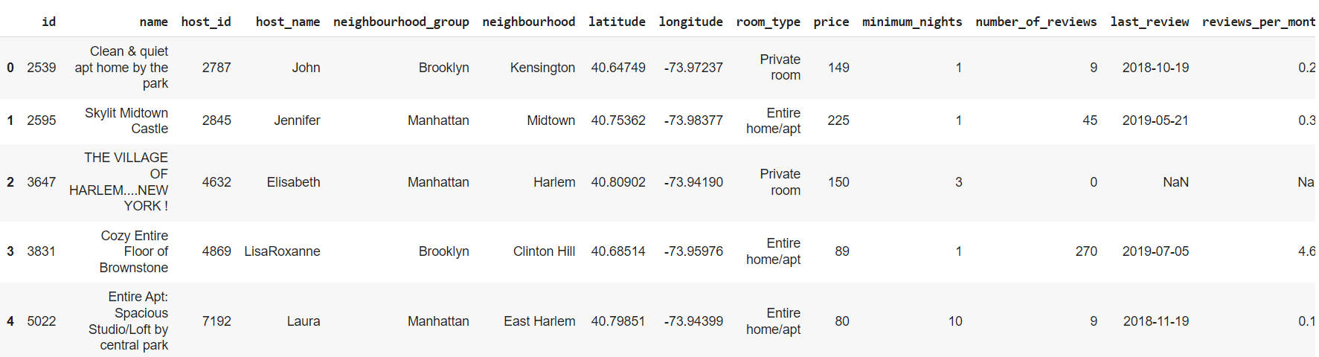
Data Extraction & Identifying Columns
(Data is extracted from a CSV file)
Airbnb dataset has 49000 rows & 16 columns
Notes:
Data extraction and identify columns which are numerical and categorical. So we can see our data contains 49,000 rows and 16 columns

Slide 8
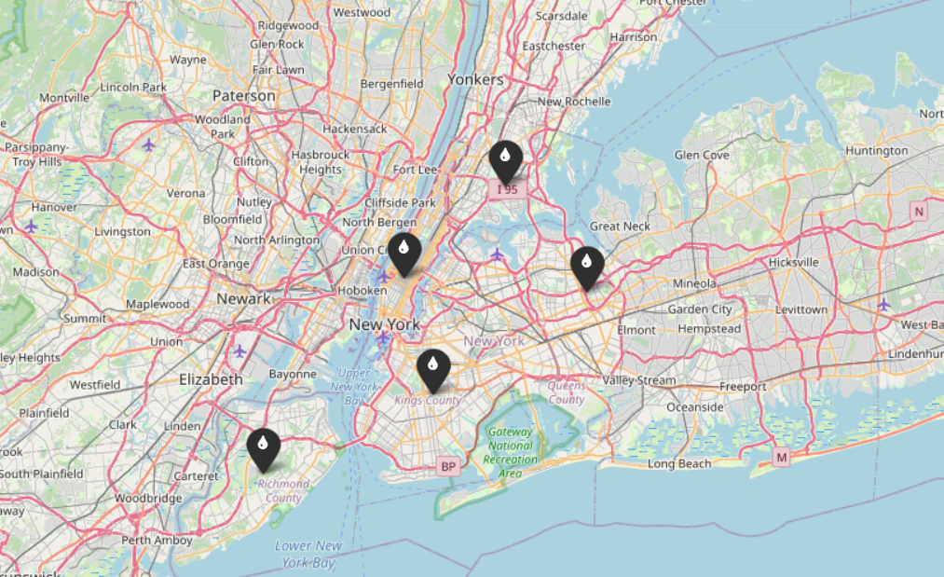
Importing Folium & adding markers to show every neighborhood group
(Folium is a library in python used for visualizing Geospatialdata)
These 5 places are also called Boroughs of New York :-
Manhattan
Brooklyn
Bronx
Queens
Staten island
Together forms the new York city
Bronx
Manhattan
Queens
Brooklyn
Staten Island
Notes:
We have displayed this map by importing folium which is a pythin library used for visualizing geospatial data. So we can see the neighbours of the new York also called boroughs

Slide 9
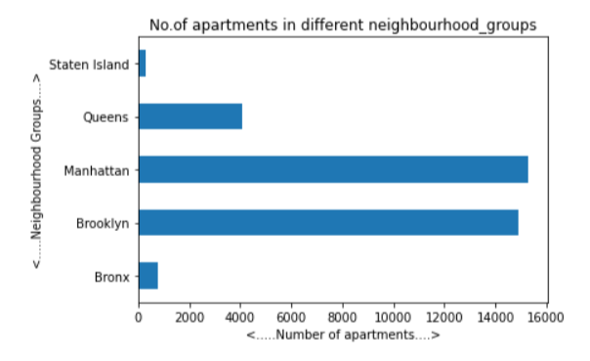
No. of apartments in different neighbourhood_groups
Neighbhourhood groups having highest no. of apartment
Manhattan
Brooklyn
Queens
Bronx
Staten Island
Observation
Manhattan has the highest no of apartments followed by Brooklyn & Queens, but there is very huge gap between 2nd & 3rd neighbour. The 4th no neighbour is Bronx & the Staten Island has the least no of apartments in the whole neighourhood

Slide 10
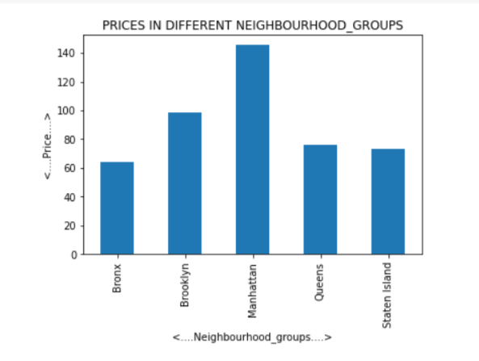
Price of apartments varying in different neighbourhood groups
Prices according to neighbourhood groups
Manhattan
Brooklyn
Queens
Staten Island
Bronx
Observation
We can see that Manhattan offers the highest price to the people & Bronx gives the cheapest deal to people in night staying

Slide 11
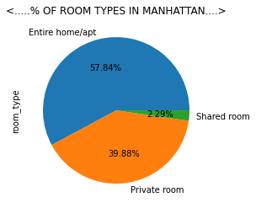
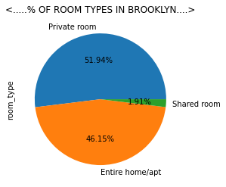
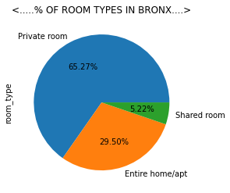
Percentage of room types in every neighbourhood groups
Observation
In Manhattan mostly the people rent their Entire home> Private room >Shared room
But in Brooklyn, Bronx, Queens, Staten Island mostly rent their Private room> Entire home> Shared room

Slide 12
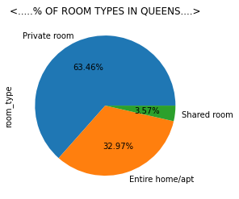
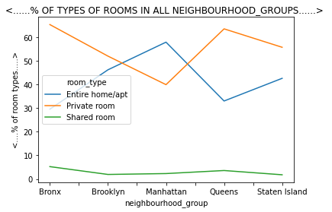
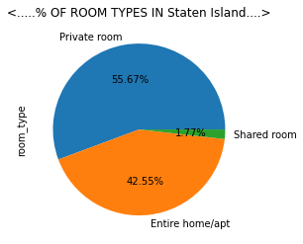
Percentage of room types in every neighbourhood groups
Observation
Bronx & Queens have higher share of Private room & Shared room as compared to Brooklyn & Staten Island

Slide 13
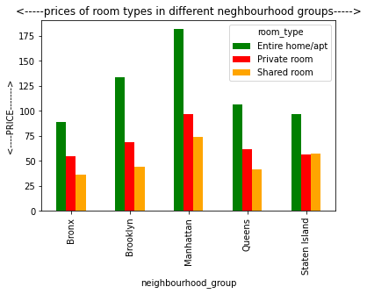
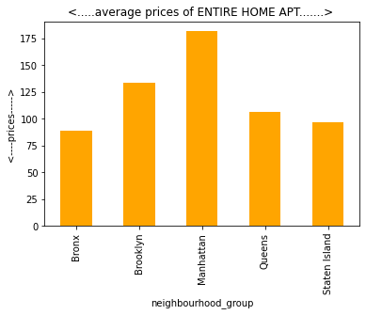
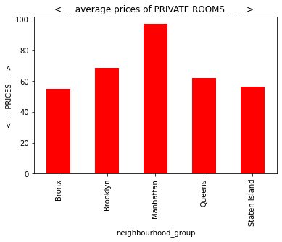
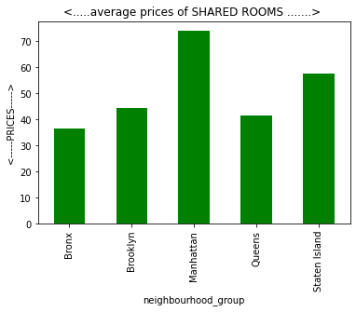
Comparing the prices of room types for different neighborhood groups
Observation
Manhattan Offers highest price among all the places for all room types
Bronx Offers the cheapest among all the places for all room types
Manhattan’s Private rooms price is higher incompare to Bronx Entire home
Manhattan Shared rooms price is higher in compare to other four neighbourhood Private rooms price
In Staten Island, Shared rooms price is higher than it’s own & Bronx’s Private rooms

Slide 14
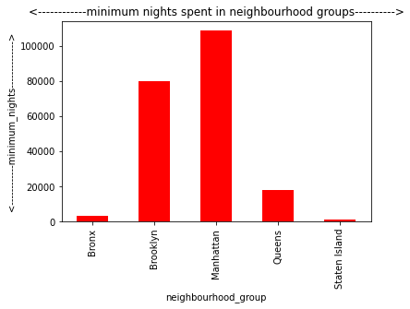
Neighborhood Group which got the most no. of visitors
Neighbourhood group
Manhattan - 108657
Brooklyn - 79806
Queens - 17758
Bronx - 3113
Staten Island - 939
Observation
Manhattan & Brooklyn have a great no. of visitors
Rest neighbours have very less visitors as compared to these two

Slide 15
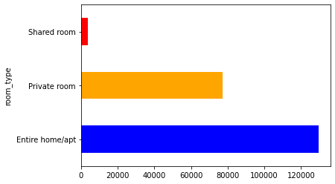
Room type people prefer the most for staying
Room_type :
Entire Home/Apt -129486
Private room - 77170
Shared room - 3617
Observation
Most of the people prefer Entire home/apt then the other 2 options, it is because people prefer privacy & comfort instead of compromising in cheaper options
Private rooms & Shared rooms are very less in no. instead of being a cheaper option to people

Slide 16
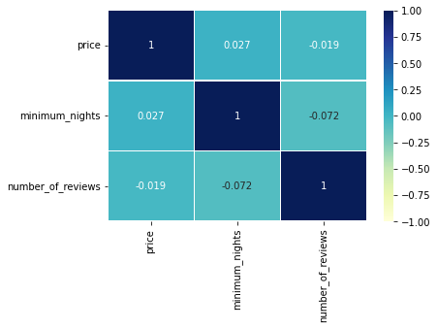
Correlation between price, minimum nights & no. of review
Observation
We are getting Negative correlation between price & number of reviews which is -0.019
Also we get a Negative correlation of minimum nights & number of reviews which is -0.072

Slide 17
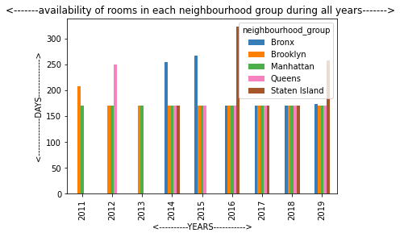
Availability of rooms in different 'neighbourhood_groups' Yearly
In 2011: Rooms are available only in Manhattan & Brooklyn, Brooklyn had higher availability of rooms in 2011
In 2012: Queens comes in the competition With the other two but was higher in availability, whereas Manhattan & Brookyln had same number of availability
In 2013: Again the same Rooms are available only in Manhattan & Brooklyn
In 2014 & 2015: Rooms are available in all the neighbourhood group but Bronx has highest availability
In 2016: Rooms are available in all neighbourhood group but has higher availabilityin Staten Island
In 2017 & 2018: Rooms are available in all neighbourhood group & the availability also remains same for all
In 2019: Rooms are available in all nieghbourhood group & availability is highest in Staten Island & Bronx goes slightly up from rest of 3 in availability

Slide 18
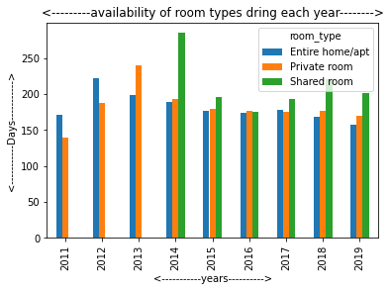
Availability of different types of room Yearly
Observation
In 2011: Only the Entire home/apt & Private rooms options was available to people.
In 2012: Availability was increased in both option but was higher in Entire home/apt
In 2013: Availability of Private rooms increased & Entire home/apt decreased as of previous year
In 2014: Shared rooms comes in option, availability series (high to low) Shared room> Private room> Entire home/apt
In 2015: Availability series was same as of 2014 but the shared room availability came down
In 2016: Availability series (high to low) private room> shared room> entire home/apt
In 2017: Availability series (high to low) Shared room> entire home/apt> private room
In 2018 & 2019: Availability series (high to low) Shared room> Private room> Entire home/apt.

Slide 19
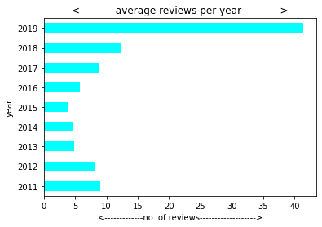
In which year Airbnb recieves the most no. of reviews
Observation
In 2015 Airbnb receives the least no of reviews
In 2019 Airbnb receives the highest no of reviews

Slide 20
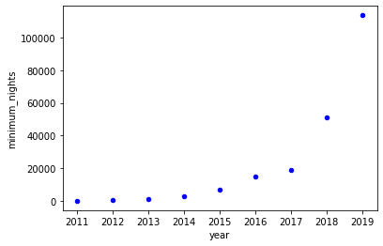
Which year brought the most no. of visitors
Observation
We can see a positive correlation between year & minimum nights in this scatter plot, as the years increase from 2011-2019 the minimum nights also increases

Slide 21
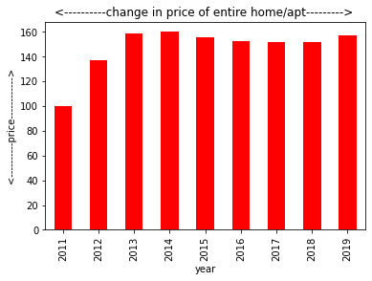
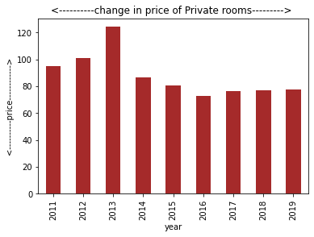
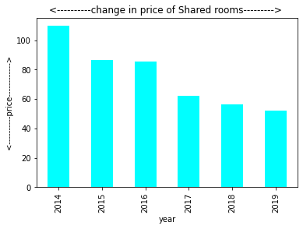
Price fluctuation of each room type around the year

Slide 22
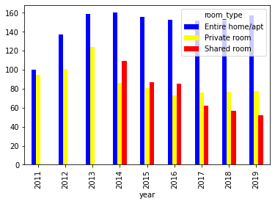
Price fluctuation of each room type around the year
Observation
Entire home/apt: The prices of Entire home/apt started increasing from 2011 and stopped at 2013, after that the price became stable between 140-160
Private rooms: At beginning the price of private rooms increased & was highest in 2013, after that it started downfall & became stable at 60-80
Shared rooms: Shared rooms market started from 2014 & it started recieveing downfall & in 2019 it is between 40-60

Slide 23
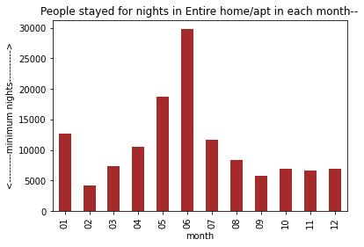
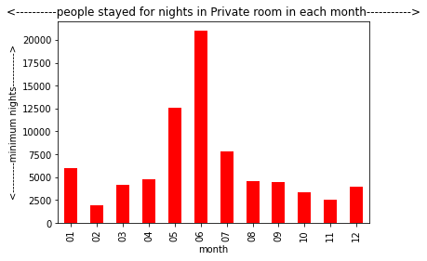
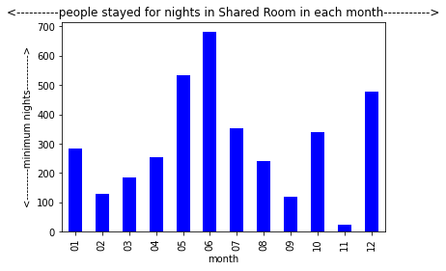
Which room types people prefer around the different months
Observation
Entire home/apt: May, June & January brings the most number of customers for Entire home/apt
Private rooms: May, June & July brings the most number of customers for Private rooms
Shared rooms: May, June & December brings the most number of customers for Shared rooms

Slide 24
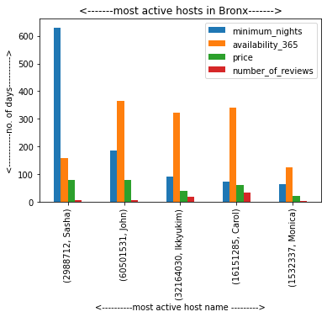
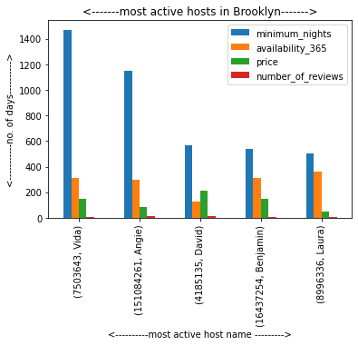
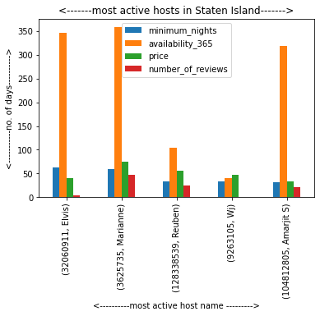
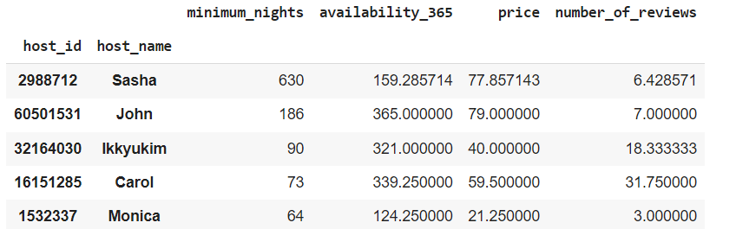
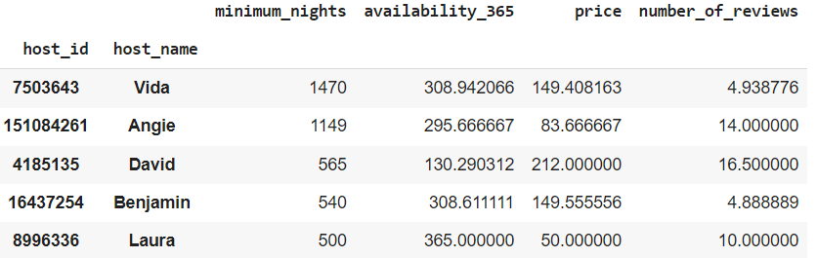
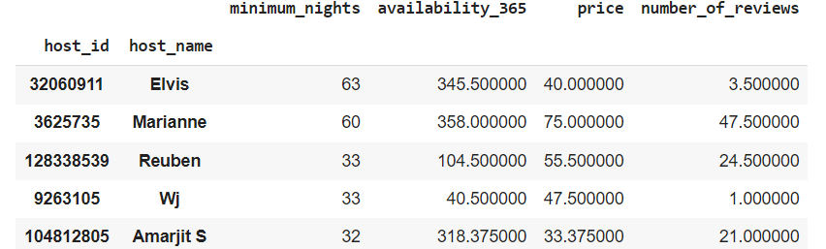
Most no of active host in different neighbourhood group
The above graph states the relationship of minimum nights with other factors such as availability of rooms, price of rooms & number of reviews
In Brooklyn these are top 5 active hosts, Whose room availability was higher during each year & the people have stayed for most no. of nights in their apartment
In Staten Island no of night spend by people is less than the other neighbourhood groups because the no of apartment is less as compared to others

Slide 25
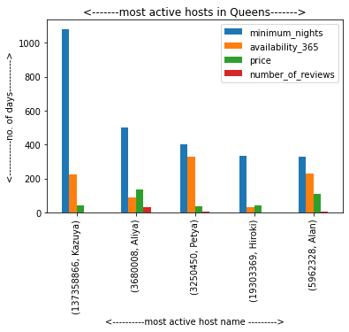
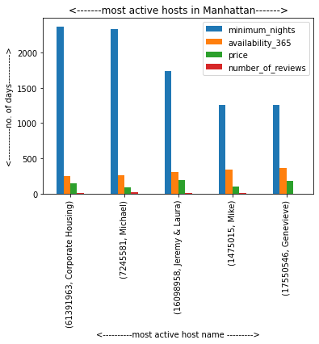
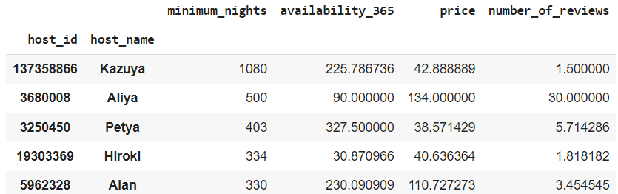
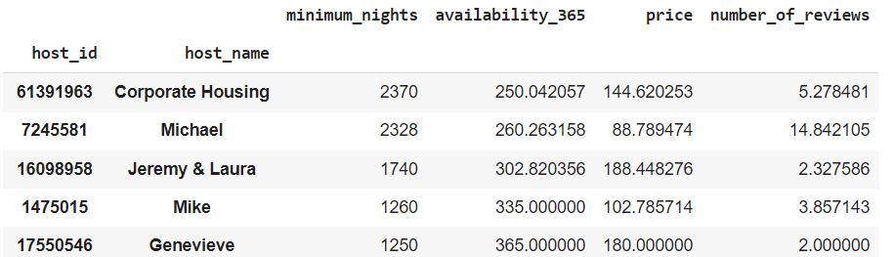
Most no of active host in different neighbourhood group
In Queens these are the top 5 hosts in graph, but in this we can see the big gap between no 1 & other 4 hosts in minimum nights number
In the Manhattan graph we can see the top 5 active hosts, the minimum nights in this is higher then other & the reason can be the availability of their apartment are higher than other hosts

Slide 26
Conclusion
Manhattan gives lead to every neighbourhood in almost every field in terms of number of apartments, highest number of visitors. It has one of the lowest availability days. In Manhattan people mostly prefer Entire home/apt, so its visitors mostly prefer Entire home/apt .
Manhattan’s Private rooms is almost equal to Queens& Staten Island Entire home/apt & greater than price of Bronx Entire home/apt. Even it’s Shared rooms is higher priced than the Private rooms of all the neighbours.
Brooklyn has 2nd most apartments in the neighbourhood & 2nd most costly after Manhattan. It has 2nd highest share in Entire home/apt. Brooklyn gets highest visitors after Manhattan. It had highest availability days in 2011.
Queens has the 3rd most apartments in the neighbourhood, but has price almost equal to Bronx & Staten Island apartments although it has huge gap in the number of apartments with them. It had highest availability days in 2012. The number of visitors is decent according to its price. It has 2nd highest share in Private rooms & 2nd lowest share in Entire home apartment.
Bronx is the most cheapest option in all the neighbourhood group but is 2nd last in visitor numbers & 2nd last in the number of apartments. It has highest share in it’s Private rooms, Shared rooms & least share of Entire home/apt .It was introduced by Airbnb from 2014 with highest availability of room & apartment.

Slide 27
Conclusion
Staten Island has less number of apartments as compared to Bronx still charges more price than Bronx as a result gets less number of visitors than Bronx, Even though having highest availability days of rooms in the neighbourhood.
Staten Island has almost same price of Private & Shared rooms. It has least share for it’s Shared rooms & 2nd highest in Entire home/apt in the neighbourhood. It also came in market from 2014.
Most of the people prefer Entire home/apt instead of Private & Shared rooms which is a cheaper option, so we can conclude that people prefer on the comfort & privacy instead on compromising them. So there is a huge gap between Private & shared rooms customers with Entire home/apt customers.
In 2011 the availability was least for Private rooms & Entire home/apt. After 2013 there was a downfall of availability in all three options as the shared rooms was introduced by Airbnb in 2014. In 2019, shared rooms has highest availability & Entire home/apt has least availability.
There was a downfall in the reviews of Airbnb from 2011-2015. After 2015 it started increasing with a high rate & has the maximum number of review till now in 2019.
In 2011, the price of Entire home/apt was least & after 2013 it became stable at 140-160. Private rooms had a price hike in beginning but started downfall after 2013 & now it is stable at 60-80. The Shared rooms was highest in its 1st year 2014 but it came down due to being overpriced & stable at 40-60.
Notes:
This is all about the presentation signing off nitin kumar thank you

